Slide 1

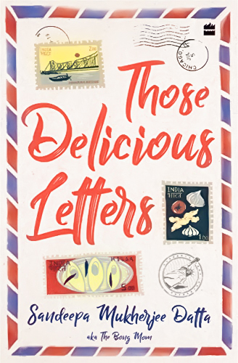

Sandeepa Mukherjee Datta
Sandeepa Mukherjee Datta is Bong Mom, the nom de plume behind the very popular blog 'Bong Mom's Cookbook'. She has been entertaining her readers with food and stories for over ten years and is the go-to source for Bengali cooking on the web. An engineer by profession, she lives with her family in New Jersey, USA.
By
Sandeepa Mukherjee Datta

Slide 2
Sandeepa Mukherjee Datta
Sandeepa Mukherjee Datta is Bong Mom. the nom de plume behind the very popular blog 'Bong Mom's Cookbook’.
She has been entertaining her readers with food and stories for over ten years and is the go-to source for Bengali cooking on the web.
An engineer by profession, she lives with her family in New Jersey, USA.
By
Sandeepa Mukherjee Datta
About
Over View
Those Delicious Letters is a captivating novel that blends the warmth of family ties with the nostalgic flavors of traditional Bengali cuisine. The story follows Shubha Sengupta, a 40-year-old woman living in the United States, whose life takes an unexpected turn when she begins receiving letters from an unknown woman in Kolkata, claiming to be her grandmother. These letters contain not only cherished recipes but also tales from the past that gradually draw Shubha back to her roots.
Author(s): Sandeepa Datta Mukherjee
Publication date: 2020-12-15
Language: English
Publisher: HarperCollins India
Age Rating: 10+
Publication year: 2020
Pages: 264

Slide 3
Sandeepa Mukherjee Datta
Sandeepa Mukherjee Datta is Bong Mom, the nom de plume behind the very popular blog 'Bong Mom's Cookbook'. She has been entertaining her readers with food and stories for over ten years and is the go-to source for Bengali cooking on the web. An engineer by profession, she lives with her family in New Jersey, USA.
By
Sandeepa Mukherjee Datta
Over View
About
Those Delicious Letters is a captivating novel that blends the warmth of family ties with the nostalgic flavors of traditional Bengali cuisine.
The story follows Shubha Sengupta, a 40-year-old woman living in the United States, whose life takes an unexpected turn when she begins receiving letters from an unknown woman in Kolkata, claiming to be her grandmother.
These letters contain not only cherished recipes but also tales from the past that gradually draw Shubha back to her roots.
Author(s): Sandeepa Datta Mukherjee
Publication date: 2020-12-15
Language: English
Publisher: HarperCollins India
Age Rating: 10+
Publication year: 2020
Pages: 264

